Slide 1
1. Introduction
  1.1. What is an operating system
  1.2. History of operating systems
  1.3. Computer Hardware Review

Slide 2
1.1. What is an operating system

Slide 3
Components of a Modern Computer (1)
  One or more processors
  Main memory
  Disks
  Printers
  Keyboard
  Mouse
  Display
  Network interfaces
  I/O devices
Tanenbaum & Bos, Modern Operating Systems: 4th ed., Global Edition (c) 2015 Pearson Education Limited. All rights reserved.

Slide 4
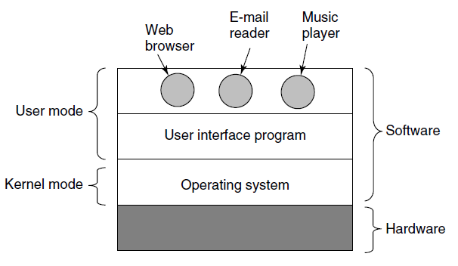
Components of a Modern Computer (2)
Most computers have two modes of operation: kernel mode and user mode. The operating system, the most fundamental piece of software, runs in kernel mode (also called supervisor mode). In particular, those instructions that affect control of the machine or do I/O are forbidden to user-mode programs.
Figure 1-1. Where the operating system fits in.
Tanenbaum & Bos, Modern Operating Systems: 4th ed., Global Edition (c) 2015 Pearson Education Limited. All rights reserved.

Slide 5
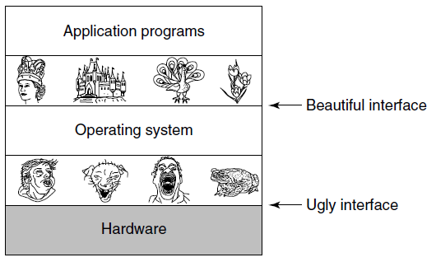
The Operating System as an Extended Machine
Figure 1-2. Operating systems turn ugly hardware into beautiful abstractions.
Tanenbaum & Bos, Modern Operating Systems: 4th ed., Global Edition (c) 2015 Pearson Education Limited. All rights reserved.

Slide 6
The Operating System as a Resource Manager
Top down view
  Provide abstractions to application programs
Bottom up view
  Manage pieces of complex system
Alternative view
  Provide orderly, controlled allocation of resources
Tanenbaum & Bos, Modern Operating Systems: 4th ed., Global Edition (c) 2015 Pearson Education Limited. All rights reserved.

Slide 7
1.2. History of Operating Systems

Slide 8
History of Operating Systems
The first generation (1945–55) vacuum tubes
The second generation (1955–65) transistors and batch systems
The third generation (1965–1980) ICs and multiprogramming
The fourth generation (1980–present) personal computers
The fifth generation (1990–present) mobile computers
Tanenbaum & Bos, Modern Operating Systems: 4th ed., Global Edition (c) 2015 Pearson Education Limited. All rights reserved.

Slide 9
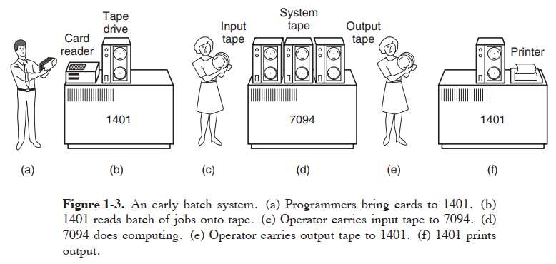
The second generation (1955–65) transistors and batch systems (1)
Tanenbaum & Bo, Modern Operating Systems: 4th ed., (c) 2013 Prentice-Hall, Inc. All rights reserved.

Slide 10
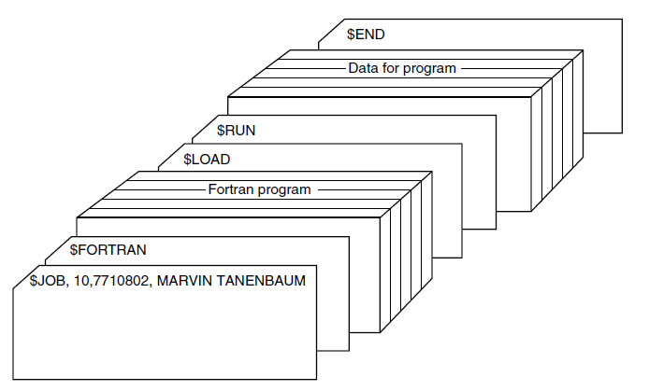
Transistors and Batch Systems (2)
The structure of a typical input job is shown in Fig. 1-4. It started out with a $JOB card, specifying the maximum run time in minutes, the account number to be charged, and the programmer’s name. Then came a $FORTRAN card, telling the operating system to load the FORTRAN compiler from the system tape.
It was directly followed by the program to be compiled, and then a $LOAD card, directing the operating system to load the object program just compiled. (Compiled programs were often written on scratch tapes and had to be loaded explicitly.)
Next came the $RUN card, telling the operating system to run the program with the data following it. Finally, the $END card marked the end of the job.
Figure 1-4. Structure of a typical FMS job.
Tanenbaum & Bos, Modern Operating Systems: 4th ed., Global Edition (c) 2015 Pearson Education Limited. All rights reserved.

Slide 11
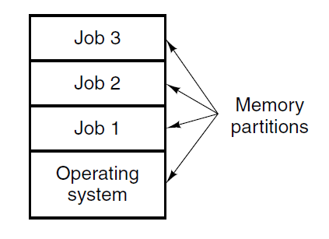
The third generation (1965–1980) Ics (Integrated Circuits) and multiprogramming
Figure 1-5. A multiprogramming system with
three jobs in memory.
Tanenbaum & Bos, Modern Operating Systems: 4th ed., Global Edition (c) 2015 Pearson Education Limited. All rights reserved.

Slide 12
1.3 Computer Hardware Review
    - CPU
    - Memory
    - I/O Devices
    - Buses

Slide 13
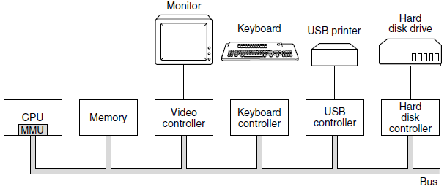
Processors (1)
Figure 1-6. Some of the components of a
simple personal computer.
Tanenbaum & Bos, Modern Operating Systems: 4th ed., Global Edition (c) 2015 Pearson Education Limited. All rights reserved.

Slide 14
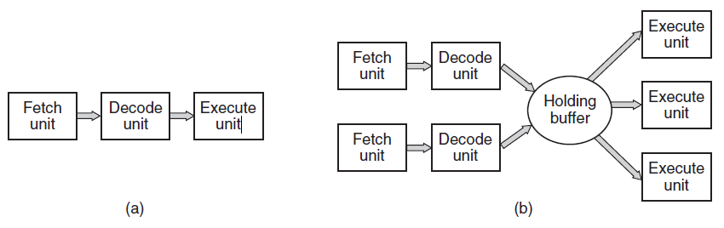
Processors (2)
Figure 1-7. (a) A three-stage pipeline. (b) A superscalar CPU.
Tanenbaum & Bos, Modern Operating Systems: 4th ed., Global Edition (c) 2015 Pearson Education Limited. All rights reserved.

Slide 15
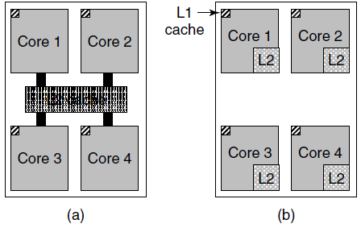
Memory (1)
Figure 1-8. (a) A quad-core chip with a shared L2 cache.
(b) A quad-core chip with separate L2 caches.
Tanenbaum & Bos, Modern Operating Systems: 4th ed., Global Edition (c) 2015 Pearson Education Limited. All rights reserved.

Slide 16
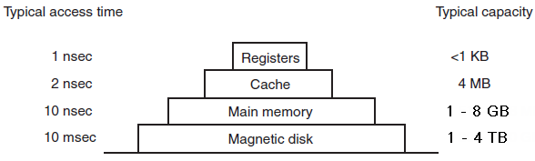
Memory (2)
Figure 1-9. A typical memory hierarchy. The numbers are very rough approximations.
Tanenbaum & Bos, Modern Operating Systems: 4th ed., Global Edition (c) 2015 Pearson Education Limited. All rights reserved.

Slide 17
Memory (3)
Caching system issues:
When to put a new item into the cache.
Which cache line to put the new item in.
Which item to remove from the cache when a slot is needed.
Where to put a newly evicted item in the larger memory.
Tanenbaum & Bos, Modern Operating Systems: 4th ed., Global Edition (c) 2015 Pearson Education Limited. All rights reserved.

Slide 18
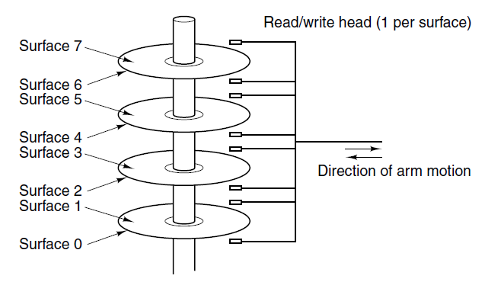
Disks
Figure 1-10. Structure of a disk drive.
Tanenbaum & Bos, Modern Operating Systems: 4th ed., Global Edition (c) 2015 Pearson Education Limited. All rights reserved.

Slide 19
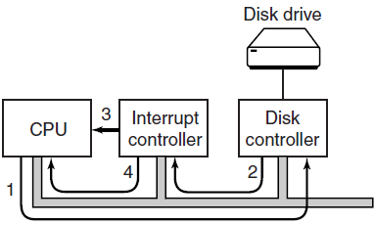
I/O Devices
Figure 1-11. (a) The steps in starting an I/O device
and getting an interrupt.
Tanenbaum & Bos, Modern Operating Systems: 4th ed., Global Edition (c) 2015 Pearson Education Limited. All rights reserved.

Slide 20
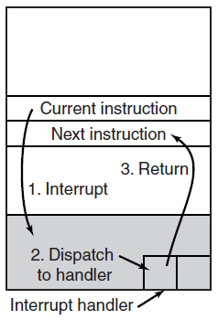
I/O Devices
Figure 1-11. (b) Interrupt processing involves taking the interrupt, running the interrupt handler, and returning to the user program.
Tanenbaum & Bos, Modern Operating Systems: 4th ed., Global Edition (c) 2015 Pearson Education Limited. All rights reserved.

Slide 21
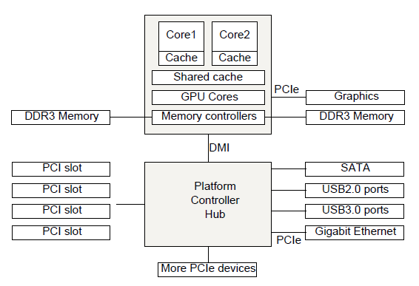
Buses
GPU = Graphics Processing Unit
DDR = Double Data Rate
DMI = Direct Media Interface
PCI = Peripheral Component
Interconnect
PCIe = … Express
SCSI = Small Computer System
Interface
SATA = Serial Advanced Technology Attachment
Figure 1-12. The structure of a large x86 system
Tanenbaum & Bos, Modern Operating Systems: 4th ed., Global Edition (c) 2015 Pearson Education Limited. All rights reserved.

Slide 22
Computer Hardware overview
Modern-day computer systems usually contain, at a minimum, the following hardware components:
The System Unit
  Motherboard (aka System Board)
  CPU (Central Processing Unit)
  Memory, such as RAM, ROM, Cache, and Flash
  Ports
  Expansion Slots
Secondary Storage, such as hard disk drives, CD-ROMs, etc.
Input / Output Devices
Communications Devices
Tanenbaum & Bos, Modern Operating Systems: 4th ed., Global Edition (c) 2015 Pearson Education Limited. All rights reserved.

